Slide 1
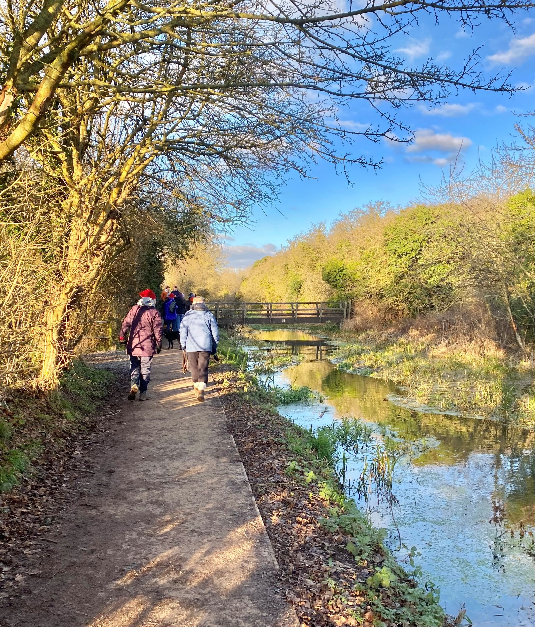
Wendover to Halton towpath upgrade – grand opening Friday 28th June 2024 10am to 3pm
Robbie Cumming of BBC 4’s Canal Boat Diaries to cut the ribbon near Walnut Tree Meadow at 1pm
A community celebration of the upgrading of this towpath
To be held on the last day of John Colet’s ‘Focus Week’
Stalls in Walnut Tree Meadow
Teddy bears’ picnic, treasure trail, nature trail worksheet and ‘passport’ for pupils of Wendover Church of England Junior School
Talks by experts on water safety, environment and ecology
Talks at sites of particular interest along the towpath
Stop-off points at heritage sites, with experts on hand
Kayakers and paddleboarders along the canal
A trumpet fanfare for the ribbon cutting
Morris dancing at 12pm and 2pm by local group Cracklewick Morris
Pizzas and coffees available in Walnut Tree Meadow
Join where you like: at Wendover HP22 6HF, Halton HP22 5NS or anywhere in-between for a celebratory walk
A shuttle bus at either end of this 1.7-mile towpath to take people back
No entry charge for the event, bus provided free
Toilets at John Colet School, Walnut Tree Meadow & Halton Village Hall.
All welcome! Bring your family and friends!
Organisers: John Colet School, Wendover News, Wendover and Halton Parish Councils, EKFB and Wendover Canal Trust. The above may be adapted up to the day.

